Slide 1
HOTEL BOOKING
ANALYSIS
Data-Driven Insights for Strategic Improvement
Presented by: Shafana Shereef
Date: 31 July 2025

Slide 2
Executive Summary
Overview of hotel booking analysis project
Goals: Identify booking patterns, reduce cancellations, and optimize revenue
Methods: Data-driven insights from key metrics

Slide 3
Data Overview
Total bookings, cancellations, revenue, ADR, etc.
Dataset fields: Booking ID, Hotel, Booking Date, Lead Time, Guests, Channel, Customer Type, etc.

Slide 4
Project Objectives
Reduce cancellation rate
Understand revenue by customer type
Optimize ADR vs. Lead Time
Analyze performance by distribution channel

Slide 5
Hotel Booking Overview
📊Total Bookings
💰Total Revenue
7127045745
29600597.44
❌Cancellation Rate %
💸Total Revenue Lost
119390
-13122900.09

Slide 6
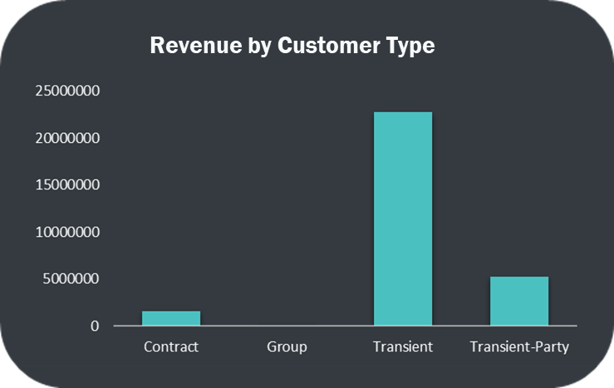
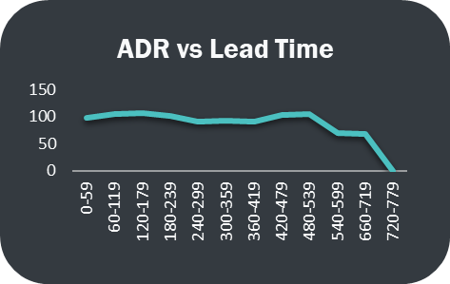
Revenue Analysis
🔹 Transient customers generate the highest revenue, contributing over 70% of total earnings.
🔹 Group and Contract segments have minimal impact on total revenue.
🔹 Focusing on the Transient segment can significantly improve profitability.
🔹 Average Daily Rate (ADR) remains stable across most lead times, showing consistent pricing.
🔹 ADR significantly drops for bookings with lead times above 600 days, indicating heavy discounts or early booking promotions.
🔹 To maximize revenue, pricing strategies should be reviewed for long lead-time bookings.

Slide 7
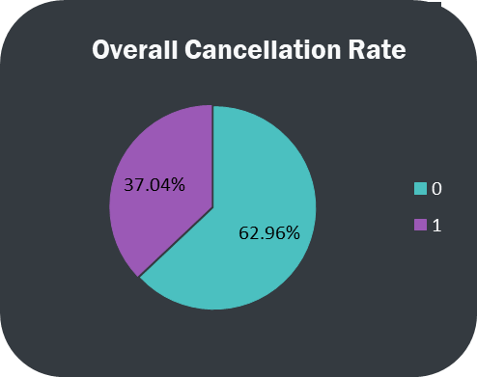
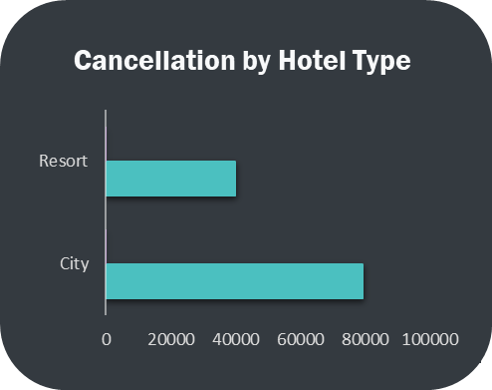
Cancellation Insights
Out of all bookings, 37% were cancelled.
This highlights a significant revenue risk — over one-third of all reservations never converted to check-ins.
Reducing this rate by even 5–10% can have a major positive impact on profitability.
City hotels account for nearly 75% of all cancellations, while resort hotels contribute just 25%.
This suggests that guests at city properties may cancel more often due to business trip changes or flexible cancellation policies.
Focused strategies like stricter policies or deposit enforcement may help reduce cancellation rates for city hotels.

Slide 8
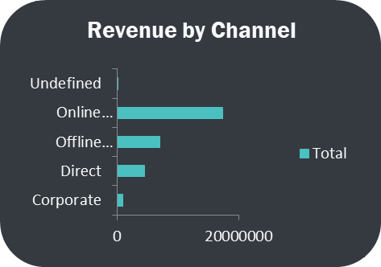
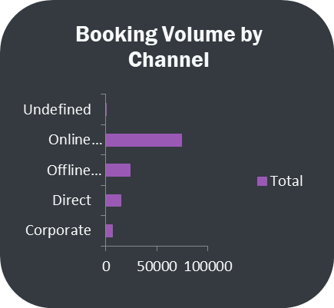
Distribution Channel Effectiveness
We recorded 119,390 total bookings across all channels.
Online Travel Agents lead with 74,000+ bookings, followed by Offline Travel Agents (24K) and Direct bookings (14.6K).
Corporate bookings are lower in volume (6.6K), but their higher revenue per booking makes them a valuable segment.
Total revenue is approximately $29.6 million, with over $17.2 million (58%) coming from Online Travel Agent A.
Corporate and Offline Travel Agents contribute $9.1M and $6.9M respectively.
These three channels account for over 90% of all revenue, highlighting their strategic importance.

Slide 9
Recommendations
Reduce Cancellation Rates
Enforce stricter policies for high-risk segments (e.g., Group, OTA) and promote refundable deposits.
Focus on Transient Customers
Transient guests generate the most revenue. Prioritize offers and loyalty for this group.
Strengthen Direct Bookings
Invest in website UX, promotions, and retention — direct channels are more stable with lower cancellations.
Optimize Long Lead-Time Pricing
Review pricing strategies for bookings made far in advance, especially where ADR drops.
Leverage High-Value Channels
Maintain strong relationships with Corporate and OTA partners who bring the most revenue.

Slide 10
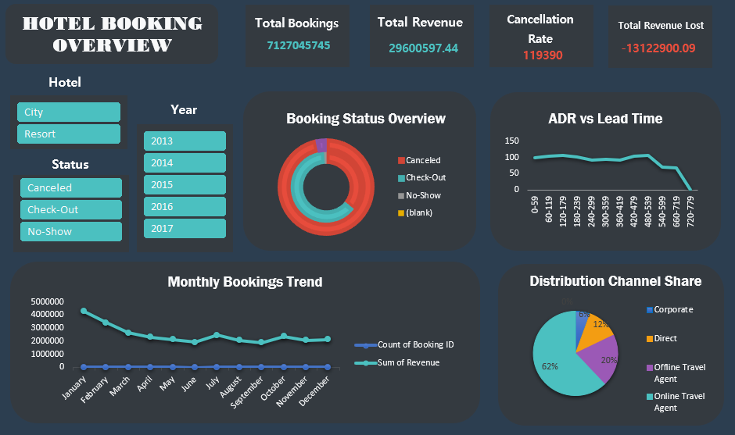

Slide 11
THANK YOU!

